Slide 1
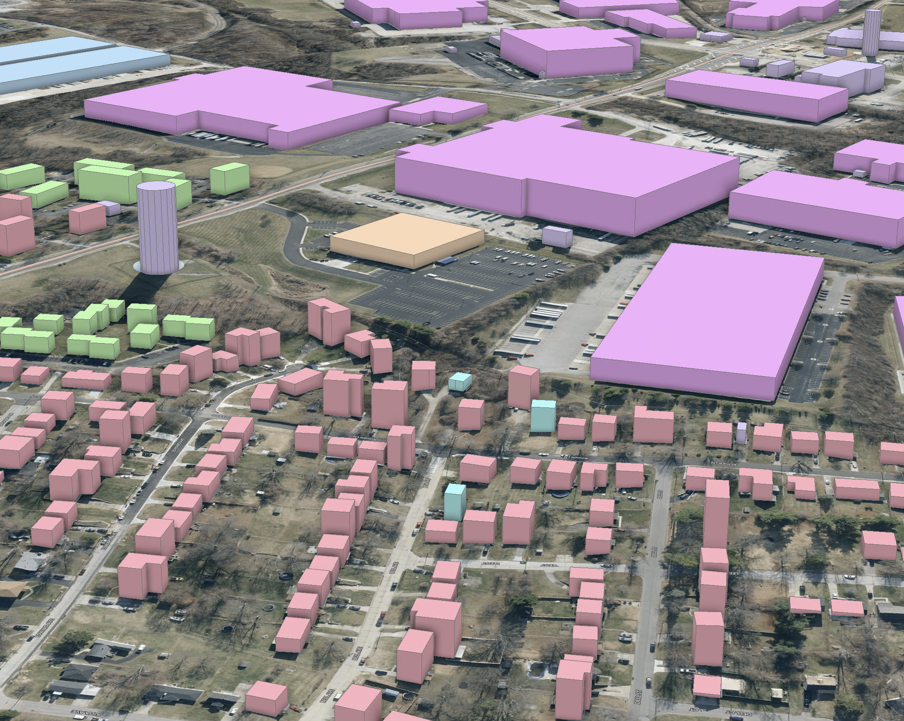

KyFromAbove
Ian Horn
ian.horn@ky.gov
A fun talk about STAC

Slide 2


Review
Last year - focused on the WHAT, WHERE, WHY of KyFromAbove in the cloud.
This year – I want to talk about the HOW of
KyFromAbove in the cloud.
Notes:
Last year what really about the what does KyFromAbove mean, where is it. This year, it’s more about how can we use.

Slide 3
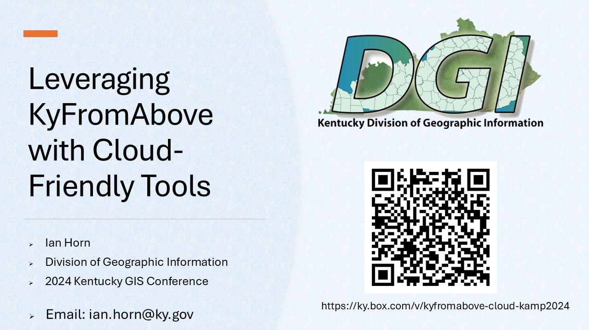
Last year’s talk
Link to last year’s talk in this year’s Sched Agenda.

Slide 4


This Photo by Unknown Author is licensed under CC BY-ND
This Photo by Unknown Author is licensed under CC BY-SA

Slide 5
But first, back to the Why?
<Insert Head Exploding Meme>
<Insert Funny Cat Gif>

Slide 6
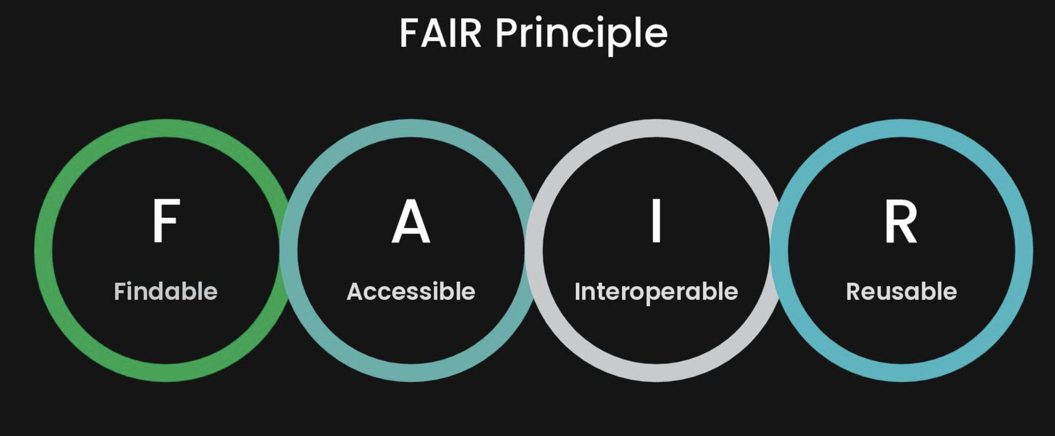

Slide 7

What next?
APPEND Static Catalog with new deliverables
Static catalog → API
What does this mean?
Find an API and just add our data as a collections
Stactools-packages, stactools pipelines
Other Federation Options – “One STAC to rule them all”
Get involved
We made it Open, help make it discoverable!

